Slide 1

Search Algorithms
Dr. Venkataramana Veeramsetty

Slide 2
List of search algorithms
Random Search
Search with closed and open list
Depth first and Breadth first search
Heuristic Search
Best First Search
A* Search
Game Search

Slide 3
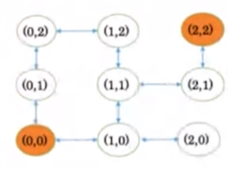
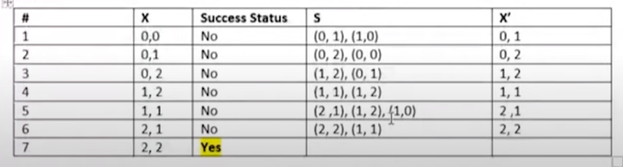
Random Search Algorithm: Example
Current Node X = Initial Node
If X=target node, stop with success
Expand X, and get set S of child nodes
Select a node X' from set S Randomly
Set X=X' go to step 2

Slide 4
Depth First Search Algorithm
A standard DFS implementation puts each vertex of the graph into one of two categories
Visited
Not Visited
Algorithm
Start by putting any one of the graph's vertices on top of a stack
Take the top item of the stack and add it to the visited list.
Create a list of that vertex's adjacent nodes. Add the ones which aren't in the visited list to the top of the stack.
Keep repeating steps 2 and 3 until the stack is empty.

Slide 5
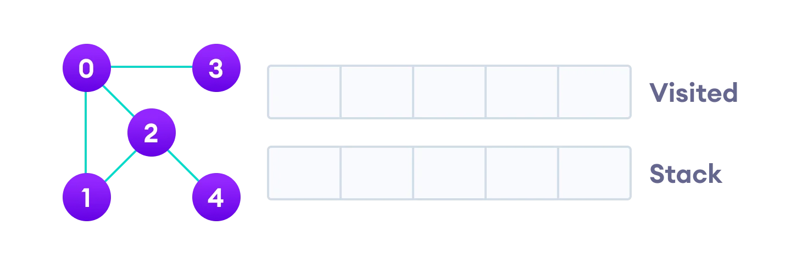
Example Let's see how the Depth First Search algorithm works with an example. We use an undirected graph with 5 vertices.

Slide 6
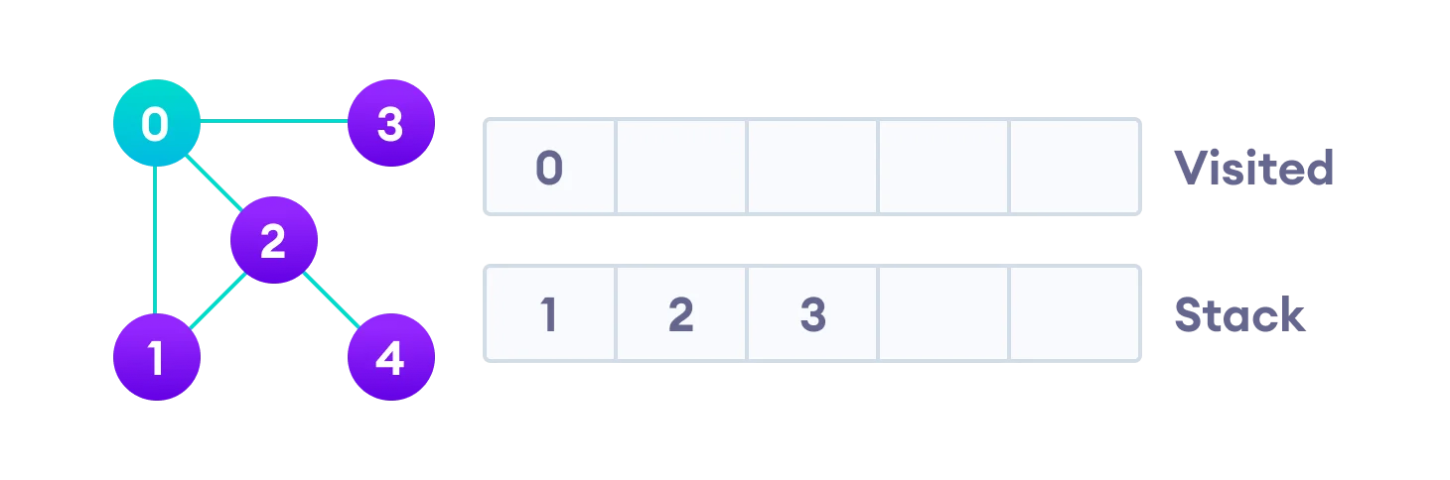
We start from vertex 0, the DFS algorithm starts by putting it in the Visited list and putting all its adjacent vertices in the stack.

Slide 7
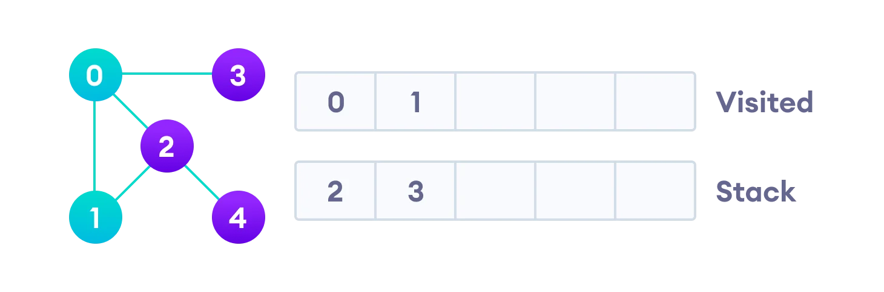
Next, we visit the element at the top of stack i.e. 1 and go to its adjacent nodes. Since 0 has already been visited, we visit 2 instead

Slide 8
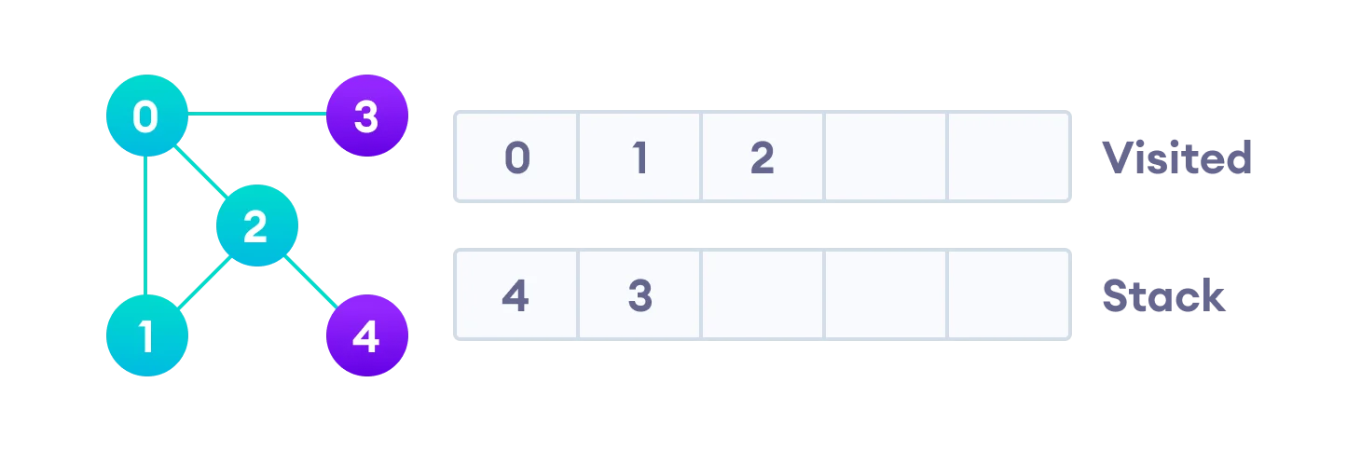
Vertex 2 has an unvisited adjacent vertex in 4, so we add that to the top of the stack and visit it.

Slide 9
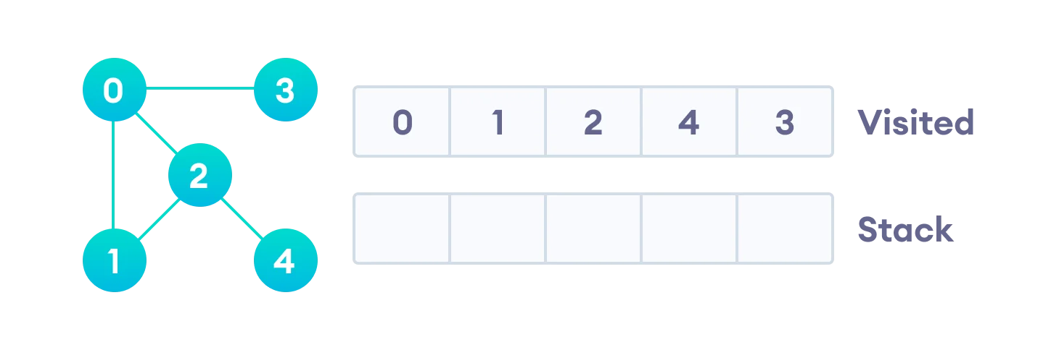
After we visit the last element 3, it doesn't have any unvisited adjacent nodes, so we have completed the Depth First Traversal of the graph.

Slide 10
Applications
For finding the path
To test if the graph is bipartite
For detecting cycles in a graph

Slide 11
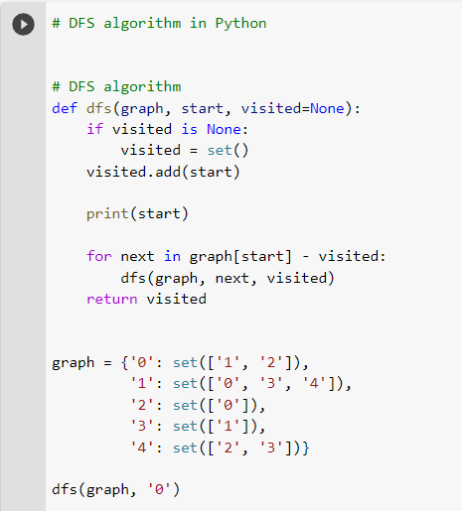
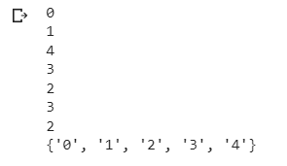
Python Implementation

Slide 12
Breadth first search
A standard BFS implementation puts each vertex of the graph into one of two categories:
Visited
Not Visited
The purpose of the algorithm is to mark each vertex as visited while avoiding cycles.
The algorithm works as follows:
Start by putting any one of the graph's vertices at the back of a queue.
Take the front item of the queue and add it to the visited list.
Create a list of that vertex's adjacent nodes. Add the ones which aren't in the visited list to the back of the queue.
Keep repeating steps 2 and 3 until the queue is empty.

Slide 13
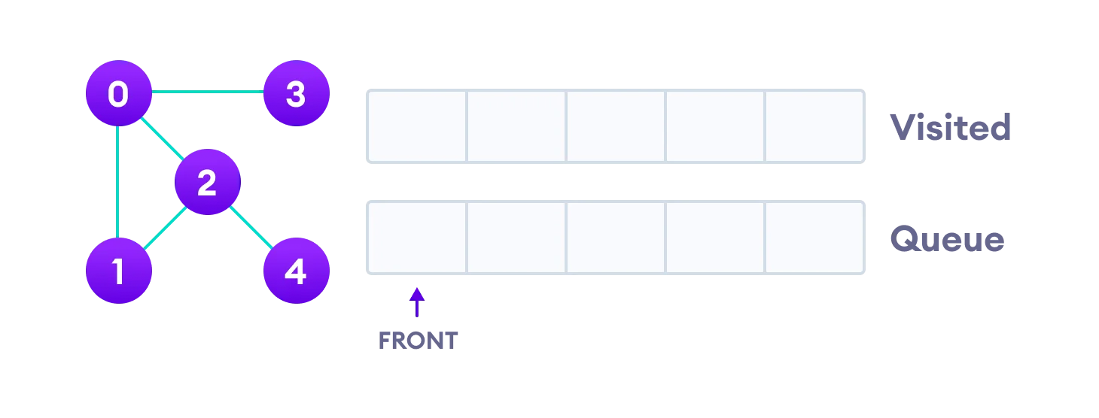
BFS example
Let's see how the Breadth First Search algorithm works with an example. We use an undirected graph with 5 vertices.

Slide 14
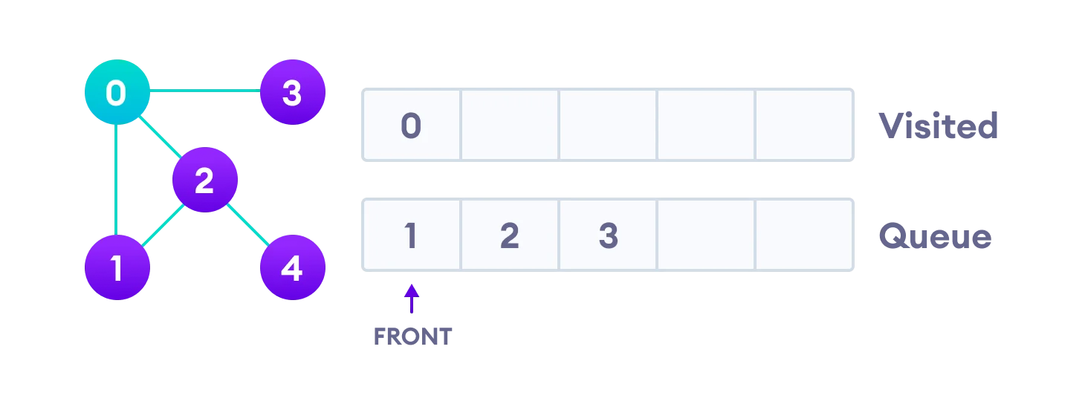
We start from vertex 0, the BFS algorithm starts by putting it in the Visited list and putting all its adjacent vertices in the stack.

Slide 15
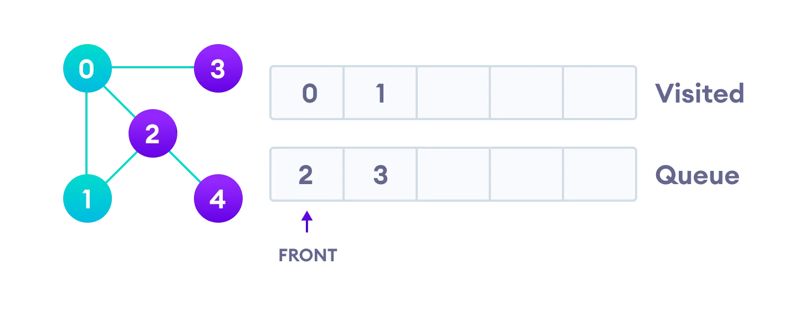
Next, we visit the element at the front of queue i.e. 1 and go to its adjacent nodes. Since 0 has already been visited, we visit 2 instead.

Slide 16
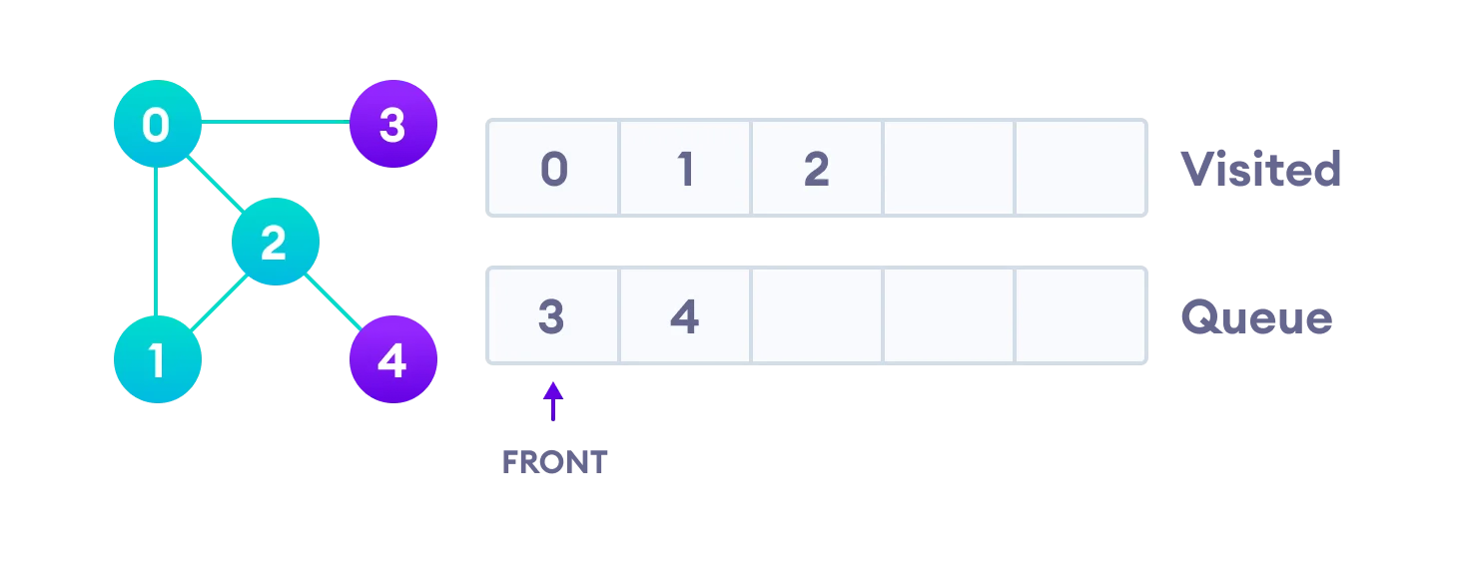
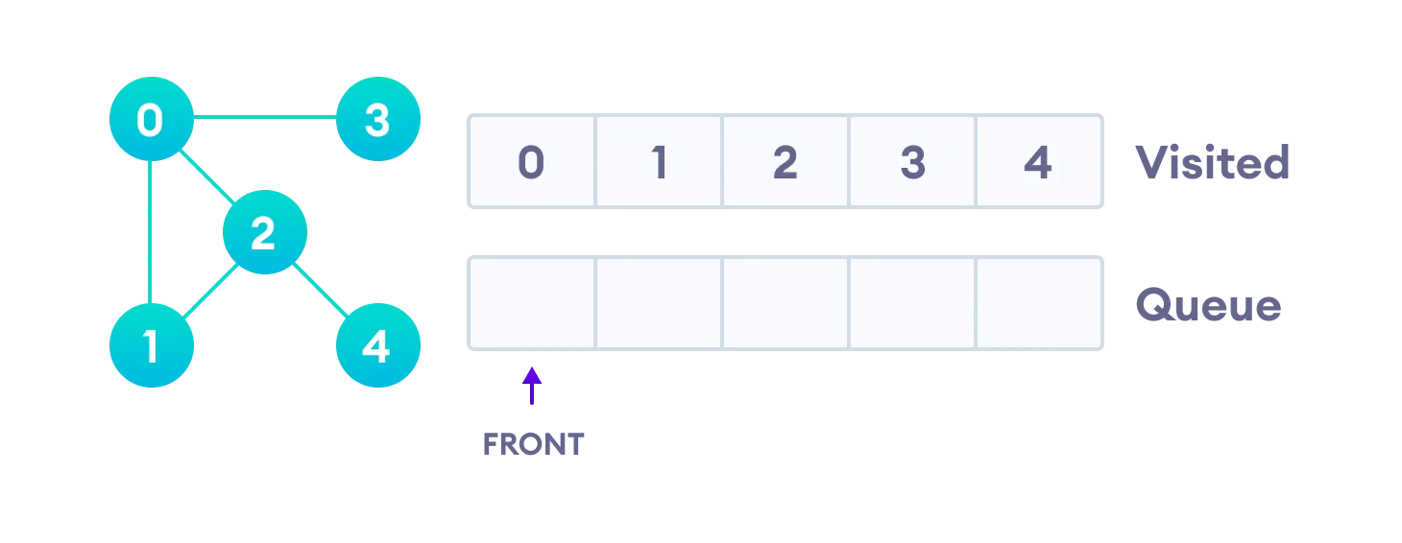
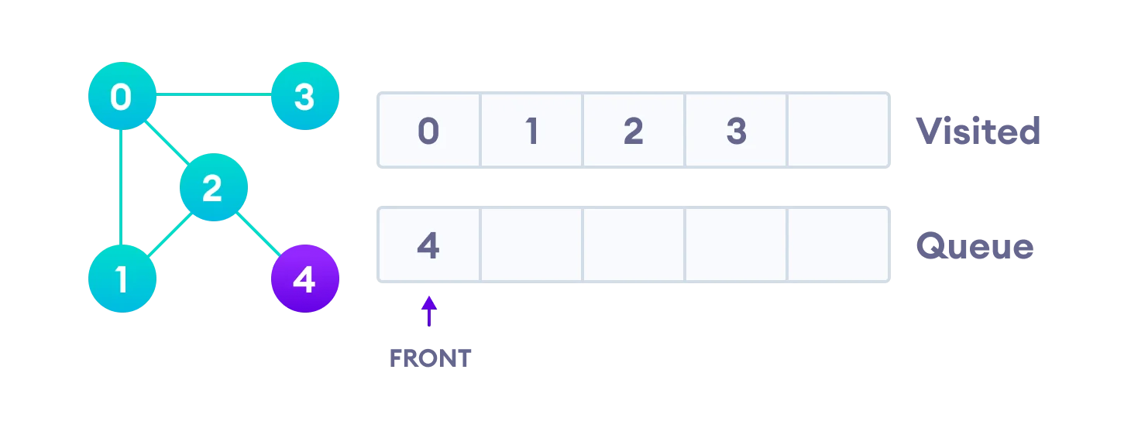
Vertex 2 has an unvisited adjacent vertex in 4, so we add that to the back of the queue and visit 3, which is at the front of the queue. Only 4 remains in the queue since the only adjacent node of 3 i.e. 0 is already visited. We visit it.

Slide 17
Applications
Path finding algorithms
Cycle detection in an undirected graph
For GPS navigation

Slide 18
Best First Search Algorithm
Create 2 empty lists: OPEN and CLOSED
Start from the initial node (say N) and put it in the ‘ordered’ OPEN list
Repeat the next steps until the GOAL node is reached
If the OPEN list is empty, then EXIT the loop returning ‘False’
Select the first/top node (say N) in the OPEN list and move it to the CLOSED list. Also, capture the information of the parent node
If N is a GOAL node, then move the node to the Closed list and exit the loop returning ‘True’. The solution can be found by backtracking the path
If N is not the GOAL node, expand node N to generate the ‘immediate’ next nodes linked to node N and add all those to the OPEN list
Reorder the nodes in the OPEN list in ascending order according to an evaluation function f(n)

Slide 19
Example
S(13)
A(12)
C(7)
D(3)
B(4)
E(8)
F(2)
H(4)
I(9)
G(0)
Step | Open | Closed
Initialization | [A,B] | [S]
Iteration 1 | [A,E,F] | [S,B]
Iteration 2 | [A,E,I,G] | [S,B,F]
Iteration 3 | [A,E,I] | [S,B,F,G]
Path: S-B-F-G

Slide 20
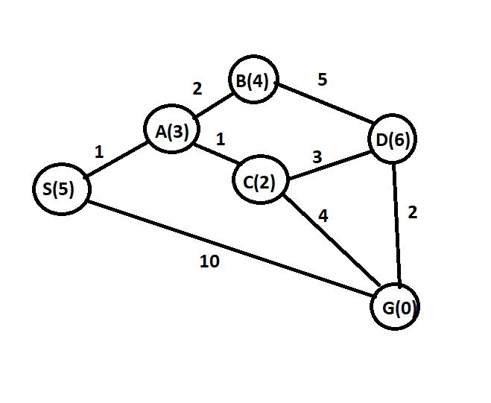
A* Algorithm
A* algorithm finds the shortest path through the search space using heuristic function
Step 1:.
S-A : F(n)=g(n)+h(n) = 1+3=4
S-G : F(n)=g(n)+h(n) = 10+0=10 Hold
Step 2:
S-A-C: F(n)=g(n)+h(n) = 2+2=4
S-A-B: F(n)=g(n)+h(n) = 3+4=7 Hold
Step 3:
S-A-C – G : F(n)=g(n)+h(n) = 6+0 =6 (Best Path)
S-A-C-D: F(n)=g(n)+h(n) = 5+6=11 Hold

Slide 21

Thank You

